Slide 1


NEXT GEN EMPLOYABILITY PROGRAM
CREATING A FUTURE-READY WORKFORCE
Student Name :
Nikita Ravsaheb Gote
Student ID :
College Name :
Annasaheb Dange College Of Engineering And Technology, Ashta
STU61533aebcc98b1632844523

Slide 2
CAPSTONE PROJECT SHOWCASE
Project Title
Exploratory Data Analysis on Space Exploration Missions Using Power BI
Abstract | Problem Statement | Project Overview | Proposed Solution | Technology Used | Modelling & Results | Conclusion | Q&A

Slide 3
Abstract
1
Objective: Analyze space exploration data for key insights.
2
Method: Utilize Power BI for visual data exploration.
3
Insights: Uncover trends and patterns for informed decision-making.
4
Impact: Empower space exploration through data-driven insights.

Slide 4


Problem Statement
Current space exploration data are dispersed across multiple sources, hindering comprehensive analysis. Extracting meaningful insights from this vast dataset poses a challenge due to its complexity. Stakeholders lack a centralized platform to access and interpret this data effectively, impacting decision-making processes. The absence of sophisticated analytical tools further exacerbates this issue. This project aims to address these challenges by conducting an in-depth analysis of space exploration missions using Power BI, providing stakeholders with actionable insights to drive informed decisions and advancements in space exploration.

Slide 5

Project Overview
Introduction: Highlight the importance of space exploration and the necessity for data-driven insights to propel future missions and advancements in the field.
Objective: Clearly state the aim of the project, which is to conduct exploratory data analysis (EDA) on space exploration missions utilizing Power BI.
Data Collection: Outline the process of gathering relevant data from reputable sources such as NASA and international space agencies.
Analysis Methodology: Describe the approach taken for data analysis, including techniques utilized within Power BI to visualize and explore the dataset.
Key Findings: Summarize the significant insights uncovered through the analysis, focusing on trends, patterns, and correlations within space exploration missions.
Impact and Future Directions: Discuss the potential impact of the project's findings on future missions, policy-making, and scientific research in the realm of space exploration, as well as possible avenues for further investigation and application of the insights gained.

Slide 6
Proposed Solution
Data Integration: Integrate space exploration data from multiple sources into Power BI, ensuring compatibility and consistency.
Data Cleaning and Transformation: Perform data cleaning and transformation within Power BI to address any inconsistencies or missing values, ensuring the dataset is prepared for analysis.
Interactive Dashboards: Design interactive dashboards within Power BI to visualize key metrics such as launch statistics, mission outcomes, spacecraft characteristics, and temporal trends.
Customized Visualizations: Create customized visualizations, such as scatter plots, bar charts, and time series plots, to explore and analyze the data in-depth.
Drill-Down Analysis: Implement drill-down capabilities within Power BI to allow users to delve deeper into specific aspects of space exploration missions, enabling more detailed analysis and insight generation.
Insightful Reports: Generate insightful reports within Power BI summarizing key findings, trends, and recommendations derived from the analysis, providing stakeholders with actionable insights for decision-making.

Slide 7
Technology used
Data Import and Integration: Power BI allows users to import data from various sources, including Excel files, databases, and cloud services. Space exploration data from sources like NASA and international space agencies will be imported into Power BI for analysis.
Data Cleaning and Transformation: Power BI provides tools for data cleaning and transformation, enabling users to address data quality issues, handle missing values, and reshape data structures as needed for analysis.
Visualization: Power BI offers a wide range of visualization options, including bar charts, line graphs, scatter plots, maps, and more. These visualizations will be used to explore key metrics and trends in space exploration missions, providing insights into launch statistics, mission outcomes, spacecraft characteristics, and temporal patterns.
Interactive Dashboards: Power BI allows users to create interactive dashboards that enable dynamic exploration of data. Interactive features such as filters, slicers, and drill-down capabilities will be incorporated into the dashboards to facilitate deeper analysis and exploration of space exploration data.
Insight Generation: By leveraging Power BI's visualization capabilities, the project aims to derive actionable insights from the space exploration data. These insights will be used to inform decision-making processes, identify trends and patterns, and uncover opportunities for further research and exploration.

Slide 8
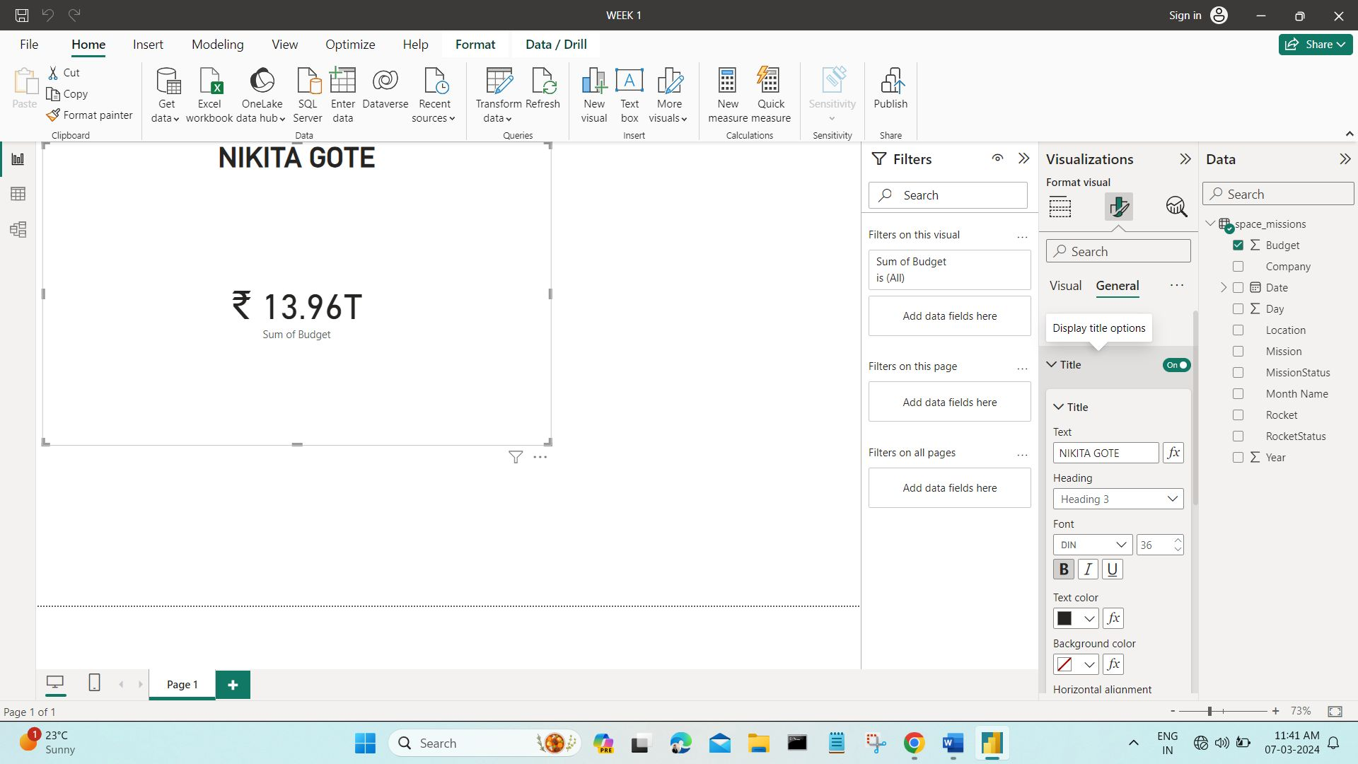
Modelling & Result

Slide 9
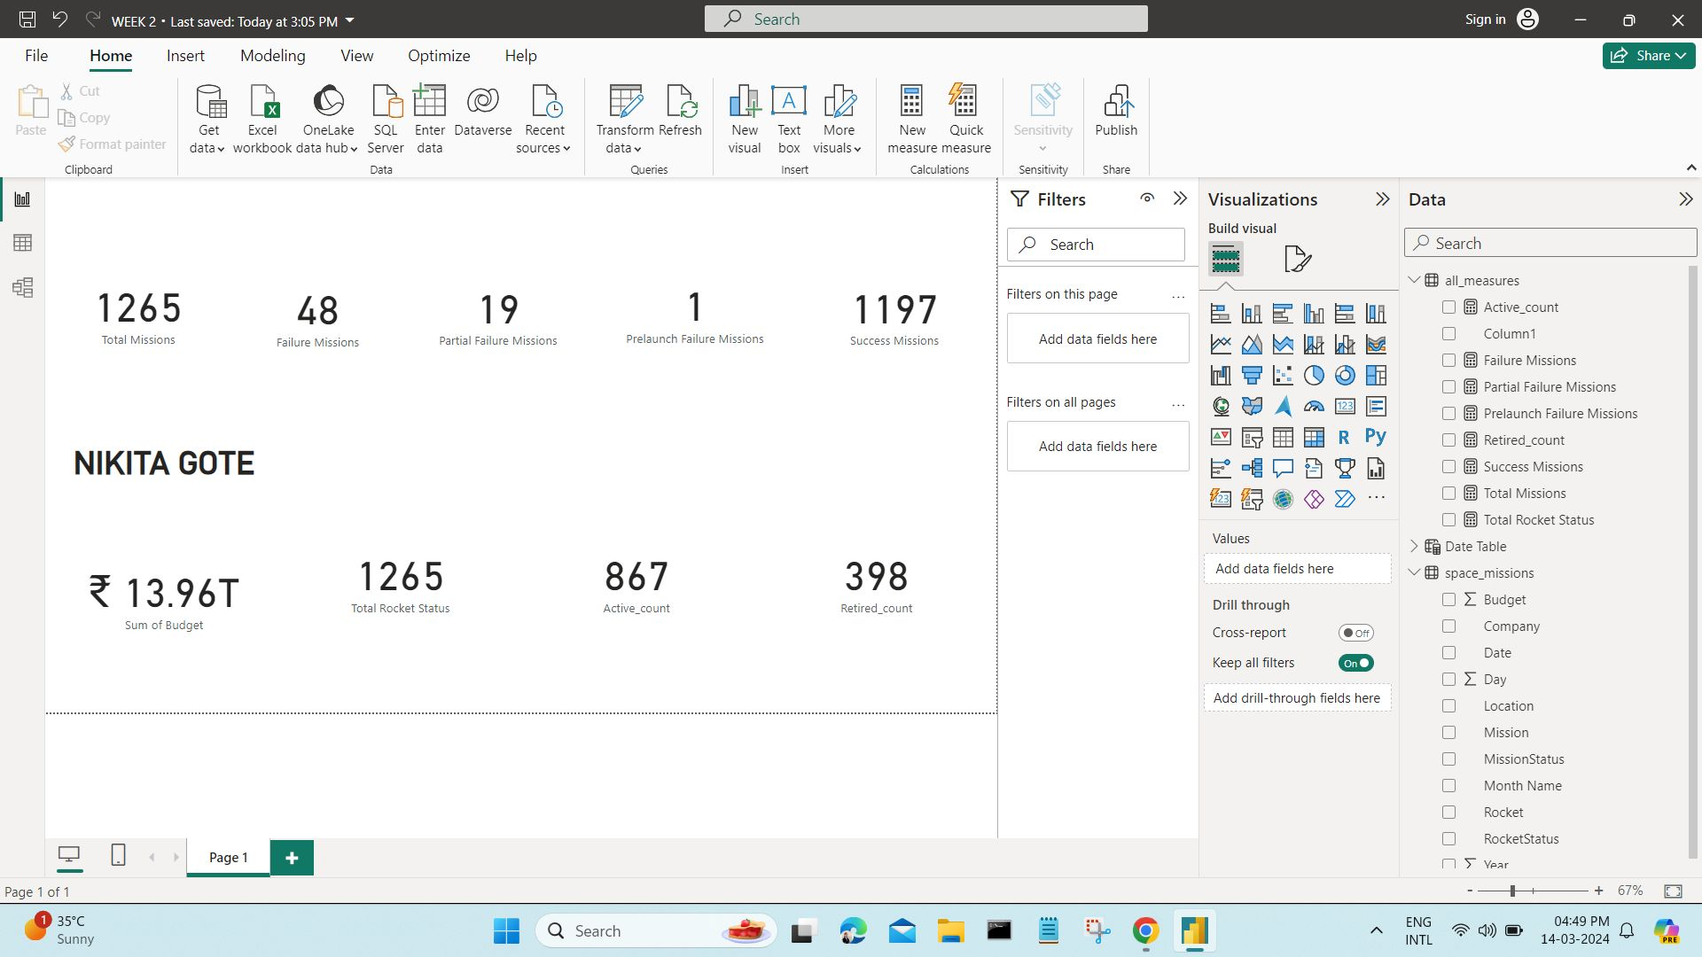
Modelling & Result

Slide 10
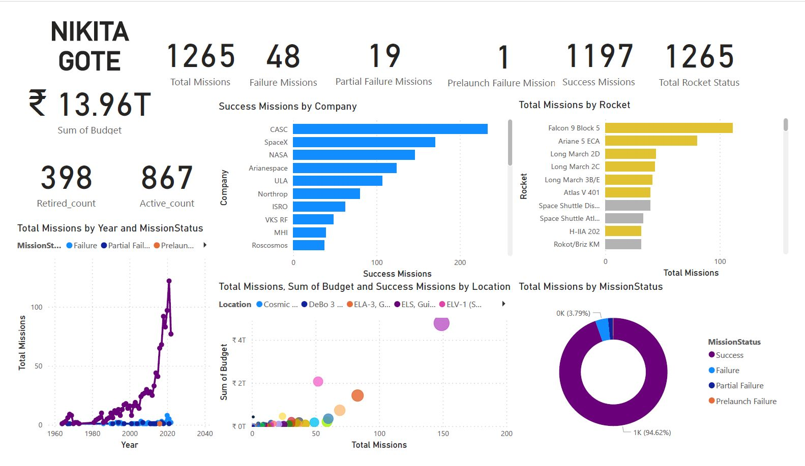
Modelling & Result

Slide 11

Conclusion
The utilization of Microsoft Power BI has proven instrumental in the successful execution of the project focusing on exploratory data analysis of space exploration missions. Power BI's seamless data integration, cleaning, and visualization functionalities have empowered stakeholders to gain deep insights into the intricacies of space missions. Through interactive dashboards and dynamic visualizations, significant trends, patterns, and correlations have been identified, paving the way for informed decision-making in future missions and policy formulations. As we navigate the complexities of space exploration, Power BI remains an invaluable tool, facilitating data-driven exploration and enhancing our understanding of the cosmos.

Slide 12


Notes:
Thank You !!

